Slide 1
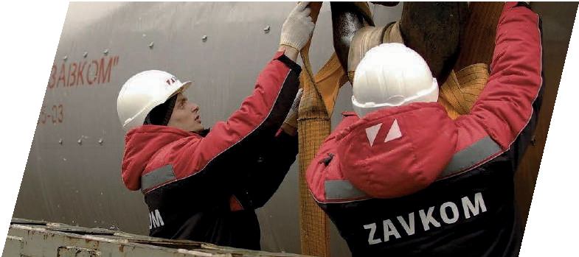
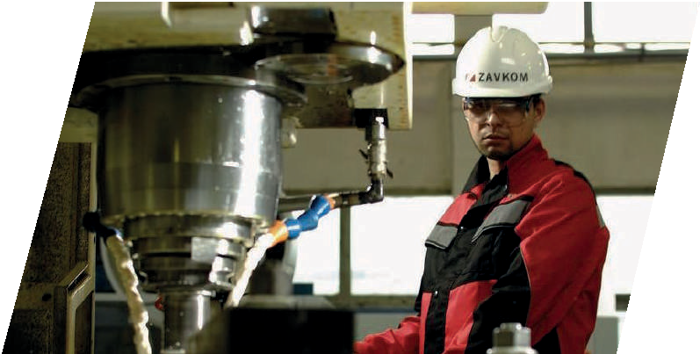
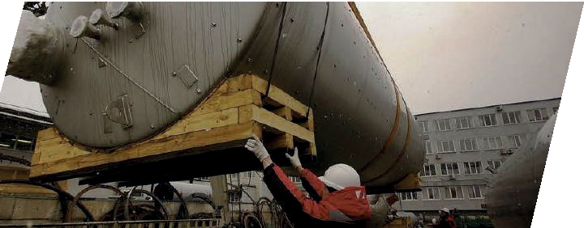
Engineering for Industrial Companies

Slide 2
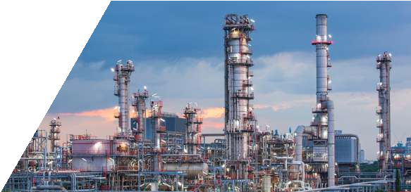
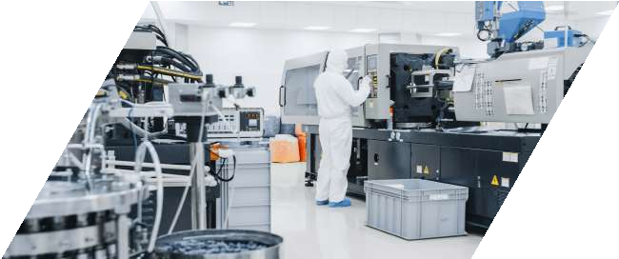
Company
ZAVKOM-ENGINEERING is a leading Russian engineering company.
Business area:
We supply :
petrochemical biotechnological
food industry facilities
01
Petrochemical
and provide a full range of engineering services.
02
Biotechnology

Slide 3
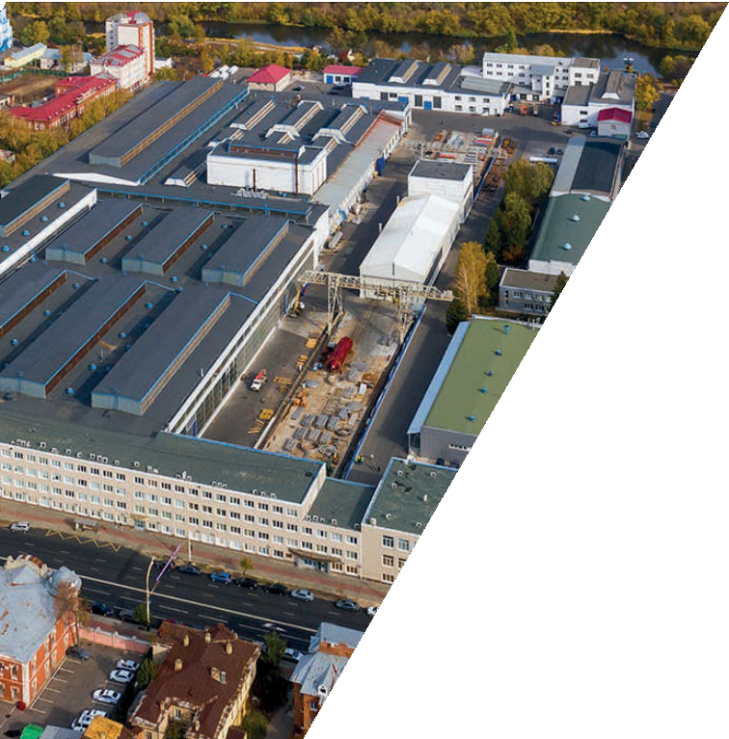
Company history
1933, the history of our company began with the creation of the Tambov Plant "Komsomolets" named in honor of N. S. Artyomov.
1933
2014, ZAVKOM-ENGINEERING became a separate company, developing the new engineering directions based on the long-term experience of the machinery-building plant.
2014
Today ZAVKOM-ENGINEERING is the reliable partner for the engineering with a foreign representative oﬃce and experience of the projects implementations around the world.

Slide 4
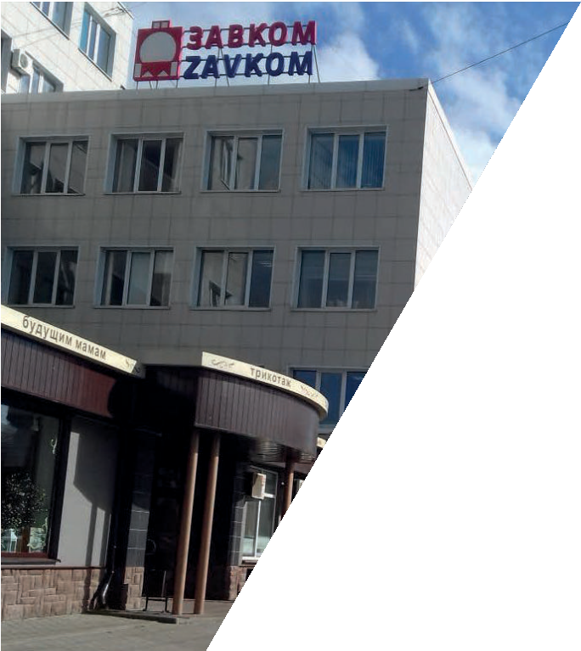
Company today
ZAVKOM-ENGINEERING is a heritage of almost 90 years' experience in engineering and production, combined with advanced existing technologies.
During several years, ZAVKOM-ENGINEERING has grown into the largest production and engineering company.
We are developing constantly, mastering modern activity areas, opening new sales markets and implementing projects of any complexity in Russia and in other countries.

Slide 5
Company Services
The ZAVKOM-ENGINEERING company provides a full range of engineering services in the petrochemical and biotechnological industries.
Preliminary design
Selection of a production licensor
Design of basic and detailed engineering
Process engineering
General engineering
Accompanying the expert examination of project design documentation
Delivery and installation of process equipment of local and foreign production
Design and delivery of Automated Process Control System
Installation supervision
Start-up works
During execution of a contract, the company is the only legally and
ﬁnancially responsible entity in front of the customer.

Slide 6
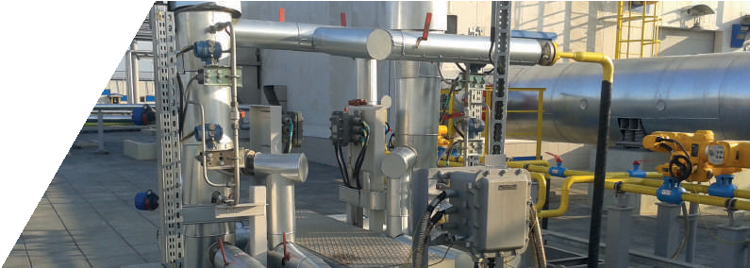
Cooperation with ZAVKOM JSC
Part of equipment for the execution of ZAVKOM-ENGINEERING's projects is produced at the facilities of the Komsomolets Plant (ZAVKOM JSC).
Equipment types:
Long-term collaborative work allows:
Column equipment,
Shell and tube heat exchangers, High-pressure reactors, Fermenters,
Tanks.
01
to reduce the volume of the customer's investment costs by optimizing the price of process equipment,
02
to accelerate the projects execution by signiﬁcantly reducing
the time for design documents approval,
03
to conclude contracts for unique projects in the Russian and foreign markets.

Slide 7
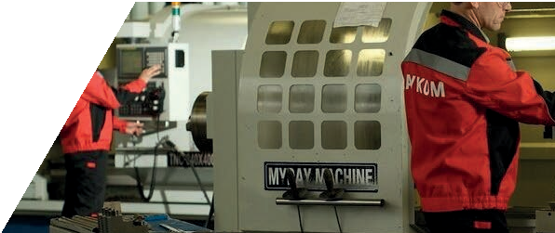
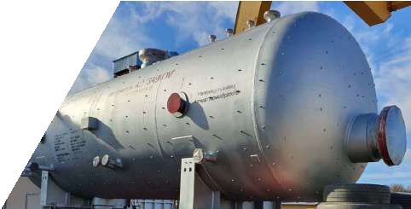
Advantages of Company
ZAVKOM-ENGINEERING works under the EPCM contracts. It gives the customers maximum certainty in understanding the contractor's responsibility for time limits, quality and productivity.
01
Experience in working with the foreign licensors.
02
Technology adjustment on the pilot units.
03
Full package of the certiﬁcates and permits.
04
Joint venture with COFCO company.
05
Vast experience in the import and export of products.
06
Work with all ﬁnancial instruments (LG, LC, SBLC, PB).

Slide 8
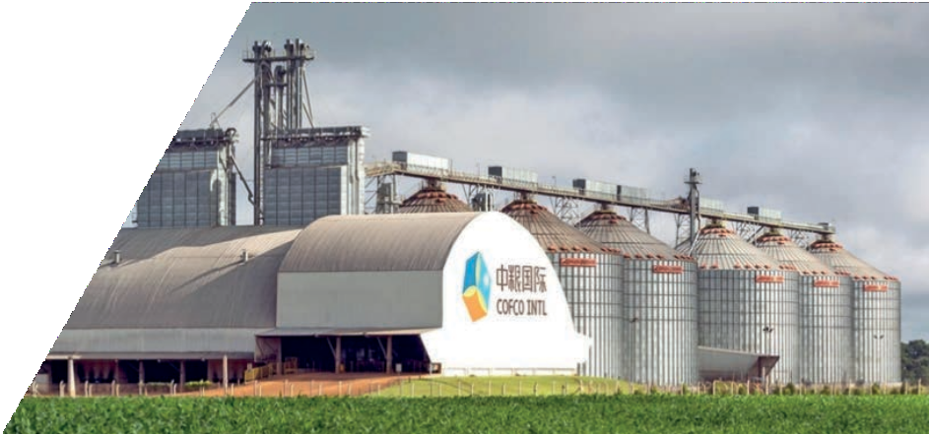
Cooperation with COFCO
Cooperation of ZAVKOM-ENGINEERING with the Chinese corporation COFCO provides new perspectives for the execution of unique projects.
COFCO is one of the 500 largest world companies
and top 1 at the list "top-100" of the food companies in China.
COFCOET-ZAVKOM is a joint venture established with the aim of transferring biotechnology to Russia, such as:
Production of native and modiﬁed
starches,
Production of starch sugar, syrups, glucose-fructose syrups, Production of amino acids,
Production of organic acids,
Other products obtained by fermentation processes.

Slide 9
Uniqueness
ZAVKOM-ENGINEERING has a number of professional advantages allowing to remain highly competitive in the market.
01
Own production gives the high-quality and timely execution of the contracts without intermediaries.
02
Customized design of Automated Process Control System optimizes production, prevents emergencies and abnormal situations and organizes remote control of all processes.
03
Using of the pilot plants helps to work out new processes before implementing it into real production.

Slide 10
Our Partners
During realization of projects, ZAVKOM-ENGINEERING cooperates with the leading Russian and European engineering companies and equipment suppliers.
Some of them have been our constant partners for many years, maintain stability in the work process and provide professional development.

Slide 11
Petrochemical Department
ZAVKOM-ENGINEERING participates in the construction of oil, chemical and petrochemical industry facilities in the following areas:
Chemicals for woodworking
Gas treatment plants
Catalytic processes
Oil reﬁning
Rectiﬁcation plants
Special equipment
Evaporation plants
Creation of pilot plants

Slide 12
Biotechnology Department
ZAVKOM-ENGINEERING supplies facilities of food and biotechnological industry.
Breweries
Production of soﬅ drinks
Distilleries
Production of kvass and juices
Alcohol plants, bioethanol production
Water treatment systems
Cognac distillery

Slide 13
Department of Biotechnology
Deep grain processing
ZAVKOM-ENGINEERING realize projects of high-tech enterprises for deep processing of wheat, corn and peas.
The technology of highest possible the extraction of valuable components from the constituents of the grain makes it possible to manufacture products with higher value added.
The prodacts of deep processing technology:
Lysine, Threonine and other Xanthan gum, Amino acids,
Lactic acid / PLA, Feed yeast,
Citric acid and other Gluten (vegetable protein), Organic acids,
Native and modiﬁed
starch,
Glucose-fructose syrups,
Enzymes.

Slide 14
Automated Process Control System
ZAVKOM-ENGINEERING installs an Automated Process Control System according to own developments, making industrial processes maximally convenient, reliable and safe.
Ensuring the uninterrupted operation of production.
Accurate and correct technological process controlling free of human factor.
Goal of Automated Process Control System:
Emergency Shutdown System is a separate subsystem that creates additional emergency protection when performing especially dangerous technological processes.
01
emergency situations
02
equipment damage
03
work-related injuries of employees
ESD system helps to exclude:

Slide 15
Functions of Automated Process Control System
The design and installation of an Automated Process Control System by ZAVKOM-ENGINEERING makes technological processes fully automated.
Collecting information about process parameters and equipment status.
Assessment of the equipment status.
Forming and giving signals of the light and acoustic alarms.
Maintaining a real-time database.
Visualizating information for the
operational staﬀ in the convenient form.
Forming shiﬅ
and daily reports.
Archivating information about process ﬂow status , disfunctions
of the technology regulations, occurrence of emergency situations.

Slide 16
Internet of Things
ZAVKOM-ENGINEERING provides the most modern services in the
ﬁeld of technology.
The development of Automated Process Control System with the consideration to the industrial Internet of Things (IoT) is a new direction in industrial automation. The advantage of this technology is the convenience and transparency of data, energy saving and ease of use.
New capabilities of the Automated Process Control System:
Analysis of a process ﬂow status in real time,
Visualization of the current processes in a convenient form,
Localization of critical points,
Advance preparation for units servicing,
Exclusion of the idle time for technical reasons.
The integration of IoT into the Automated Process Control System allows to analyze all data using artiﬁcial intelligence and the latest cloud technologies, making the production process clearer and more convenient.

Slide 17
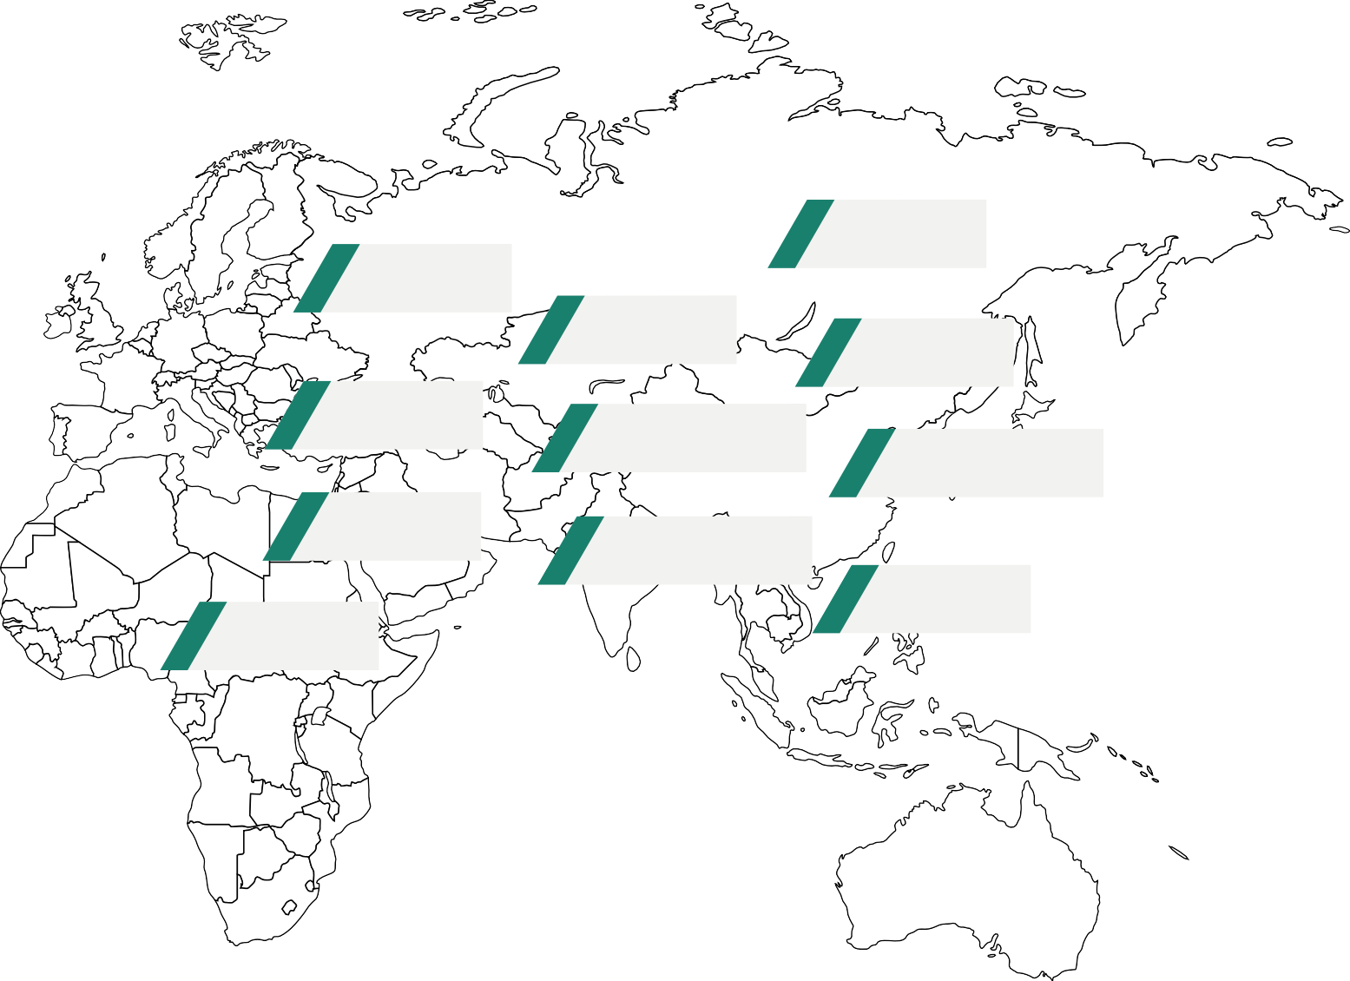
Geography of projects
The geography of the cities where we have successfully realized our contractual obligations extends far beyond the borders of Russia.
Russia
Belarus
Kazakhstan
Mongolia
Turkey
Uzbekistan
Tajikistan
Egypt
Azerbaijan
Vietnam
We are always
open for partnership!
Nigeria

Slide 18
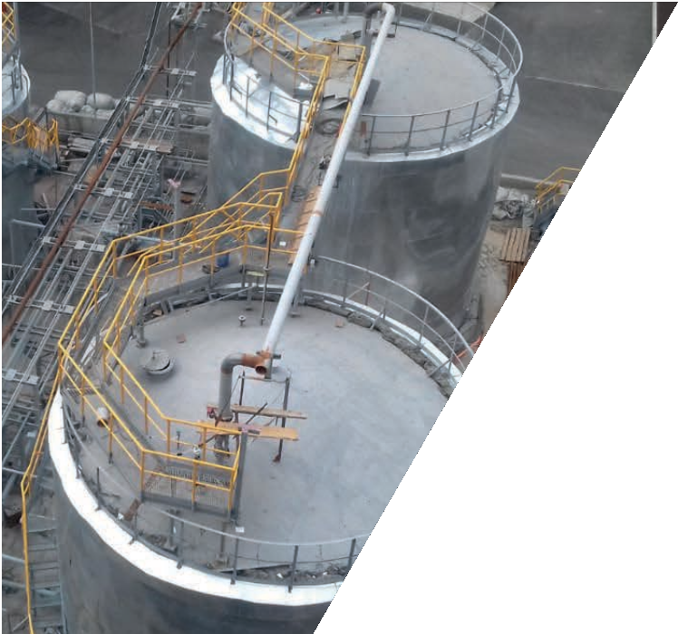
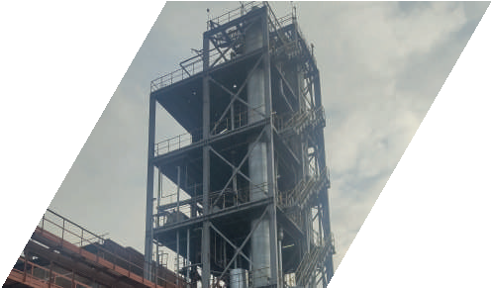
Completed projects
Naphthalene Rectiﬁcation Plant MMK
Magnitogorsk, 2018
Scope of Work
Develop of the technology for producing naphthalene from naphthalene-containing fraction.
Develop of the design and detailed documentation.
Сomplex supply of the process
equipment:
Naphthalene rectiﬁcation unit,
Raw material storage warehouse,
Storage warehouse for ﬁnished products,
Flaked naphthalene recovery unit.
Installation supervision. Commissioning works. Training.

Slide 19
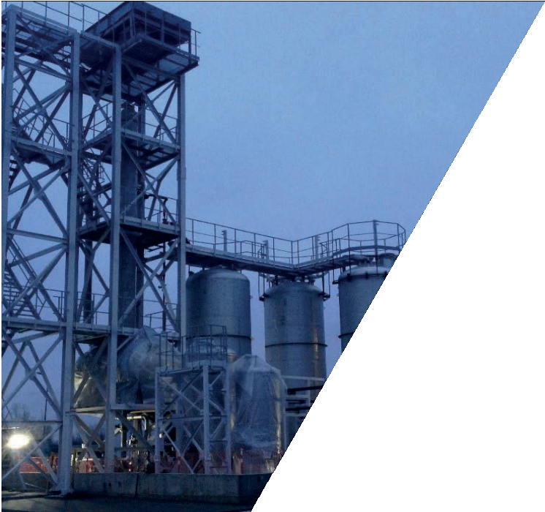
Completed projects
Rectiﬁcation unit and vacuum evaporator
GEROPHARM
St. Petersburg, 2017
Scope of Work
General design of a plant for production of pharmaceutical substances.
Develop of the design and detailed documentation.
Сomplex supply of the process
equipment:
Solvent rectiﬁcation units,
Solvent storage warehouse,
Peptide solution vacuum evaporator.
Installation work. Commissioning works.
Training.

Slide 20
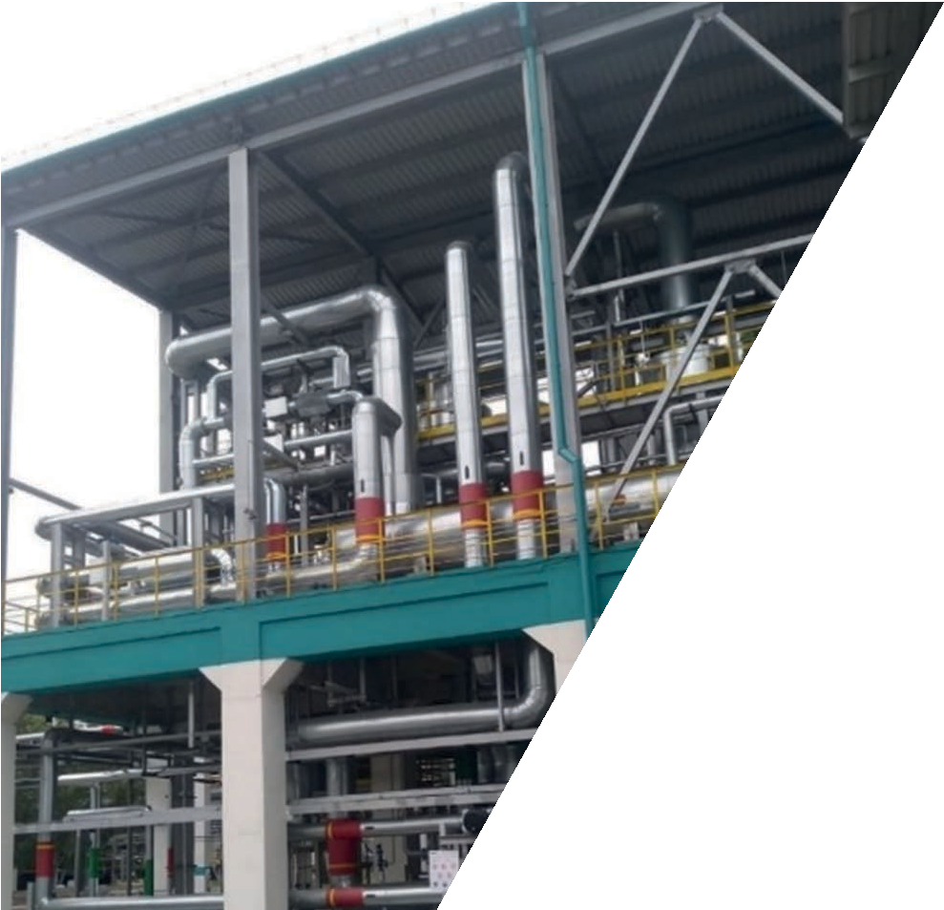
Completed projects
Vacuum-evaporator unit for local treatment facilities VORONEZHSINTEZKAUCHUK
Voronezh, 2020
Scope of Work
Develop of the design and detailed documentation.
Сomplex supply of the technological
equipment:
Vacuum-evaporator,
Lithium salt drying unit,
Lithium salt packaging unit.
Installation supervision. Commissioning works.
Training.

Slide 21
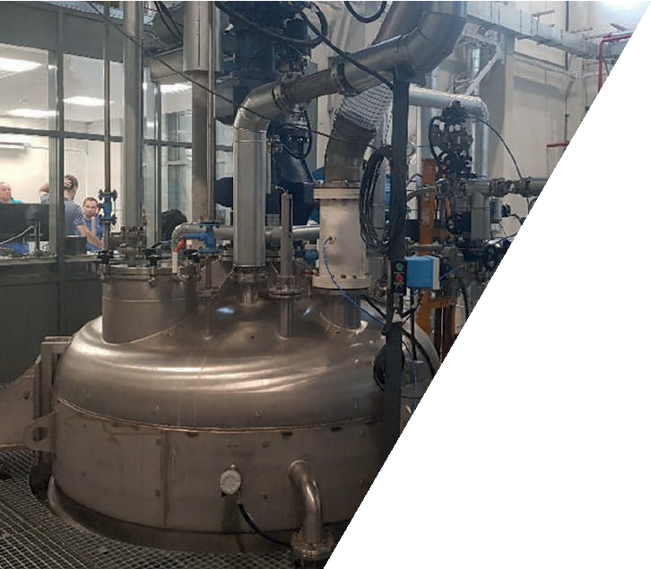
Completed projects
Urea-formaldehyde and melamine-urea- formaldehyde resin producing plant with a capacity of 20,000 tons per year SCHATTDECOR
Tyumen, 2015
Scope of Work
Develop of design and detailed documentation.
Сomplex supply of the process
equipment:
Resin production plant,
Warehouse for storage of raw materials a nd reagents,
Storage warehouse for ﬁnished products.
Installation supervision. Commissioning works.
Training.

Slide 22
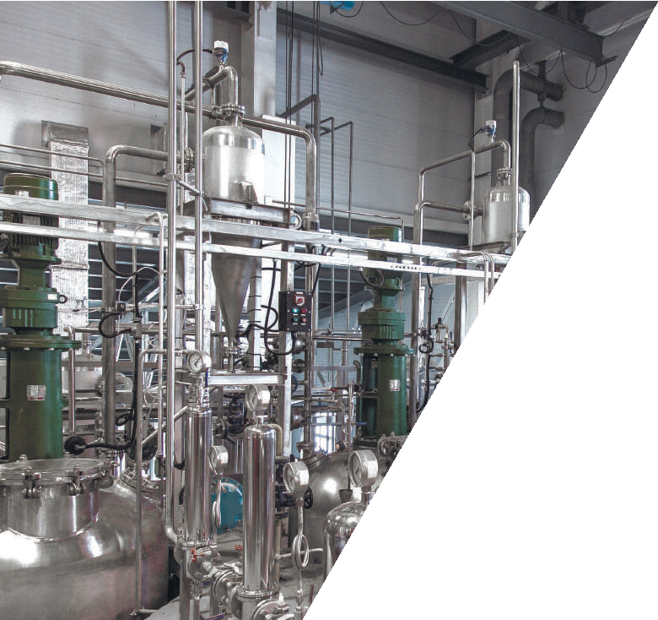
Completed projects
Wheat deep processing plant AMINOSIB
Ishim, the Tyumen Region, 2018
Scope of Work
General design.
Сomplex supply of the process
equipment.
Installation works. Commissioning works.
Training.

Slide 23
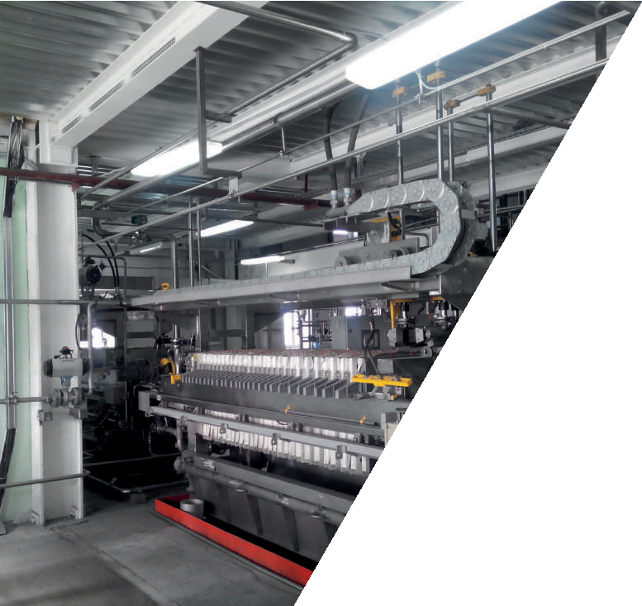
Completed projects
Plant for the production of enzyme preparations AGROFERMENT
the Tambov Region, 2014
Scope of Work
General design.
Сomplex supply of the process
equipment.
Installation works. Commissioning works. Training.

Slide 24
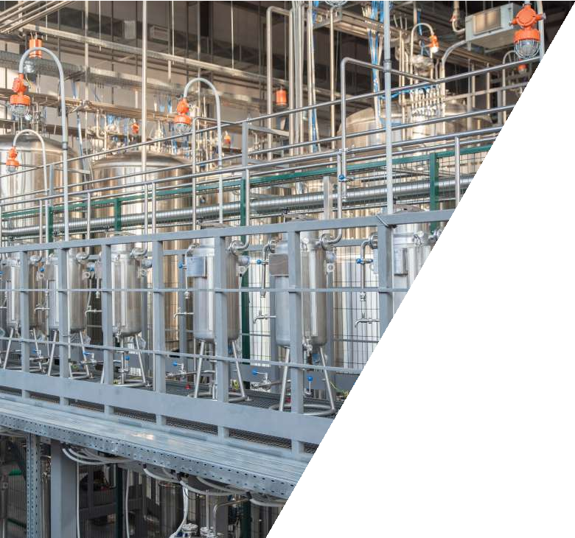
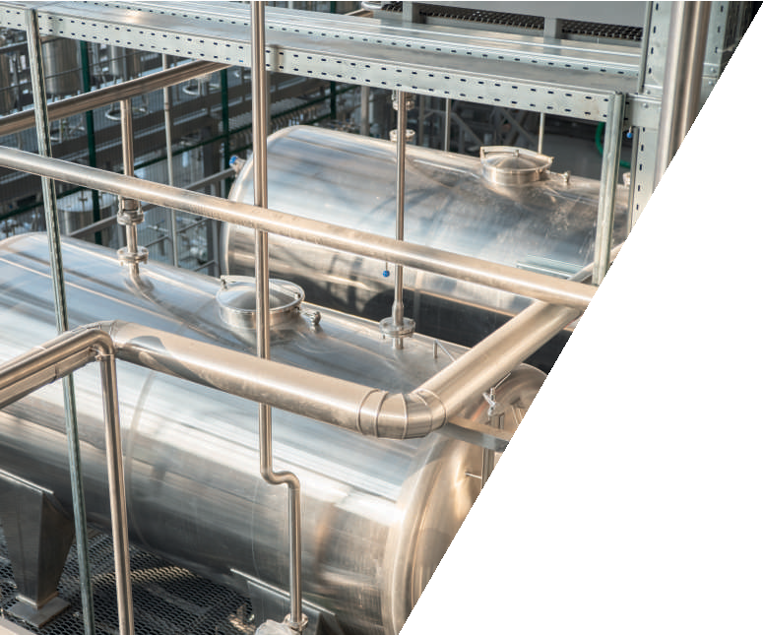
Completed projects
Distillery
PREMIUM UZBEKISTAN
Tashkent, 2020
Scope of Work
Technological design.
Сomplex supply of the process
equipment.
Installation works. Commissioning works.

Slide 25
Completed projects
Pea protein isolate production line
Customer: conﬁdential information
Skolkovo, 2021
Scope of Work
Technological design.
Сomplex supply of the process
equipment.
Installation works. Commissioning works. Training.
а
Уралхим»

Slide 26
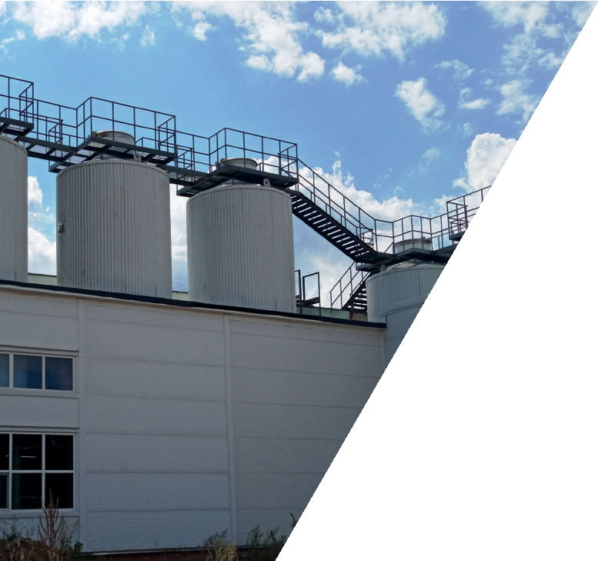
Completed projects
Beer fermentation tank MOSCOW BREWING COMPANY
Mytishchi, 2016
Scope of Work
Technological design.
Supply of the process equipment. Installation supervision.
Commissioning works.

Slide 27
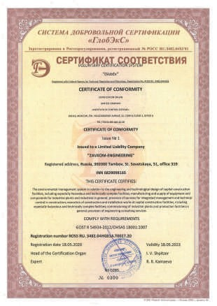
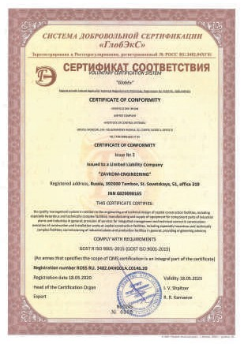
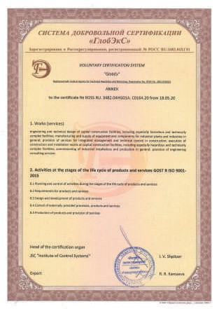
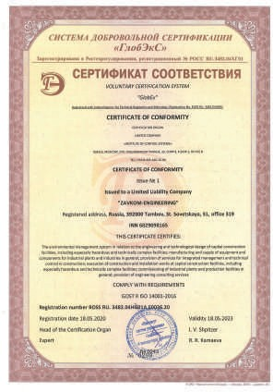
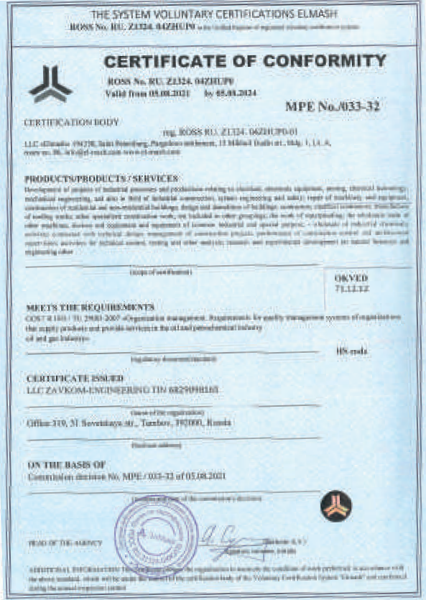
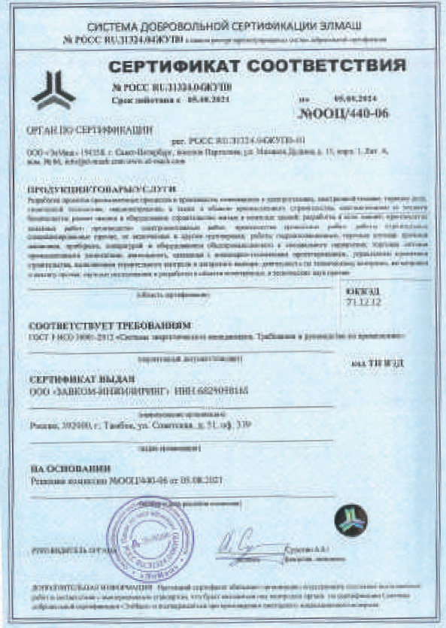
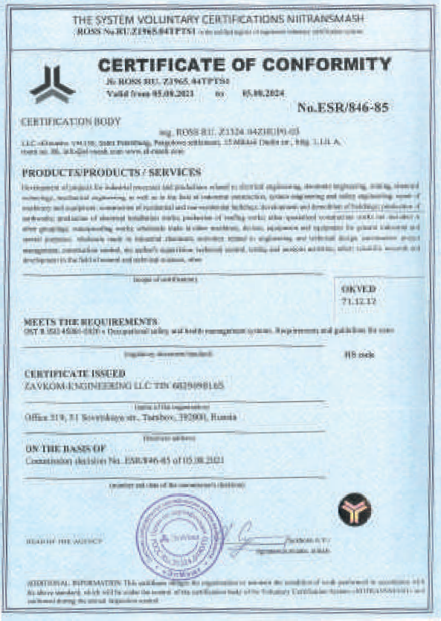
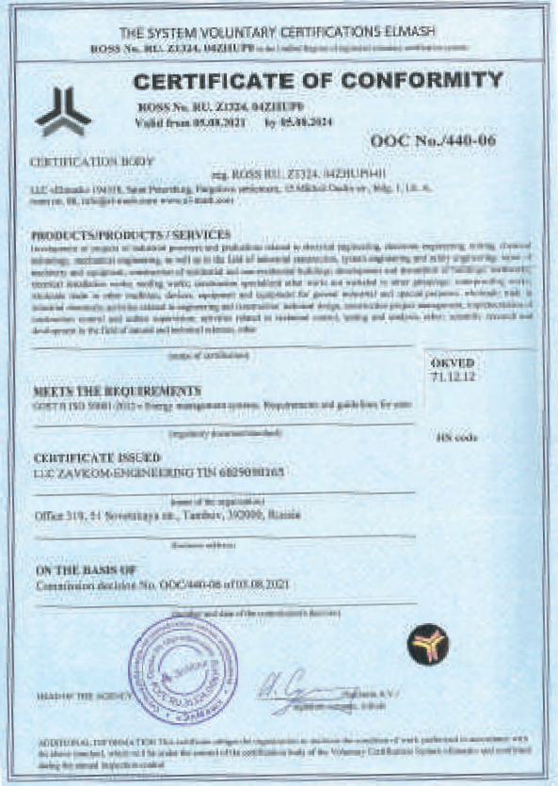
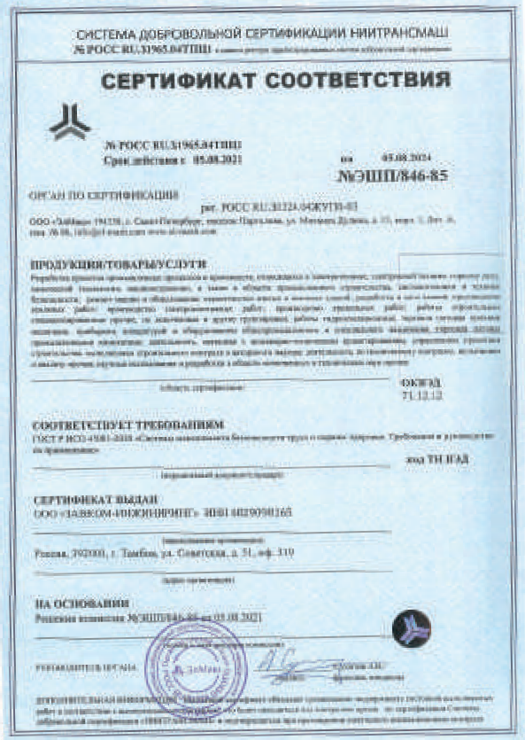
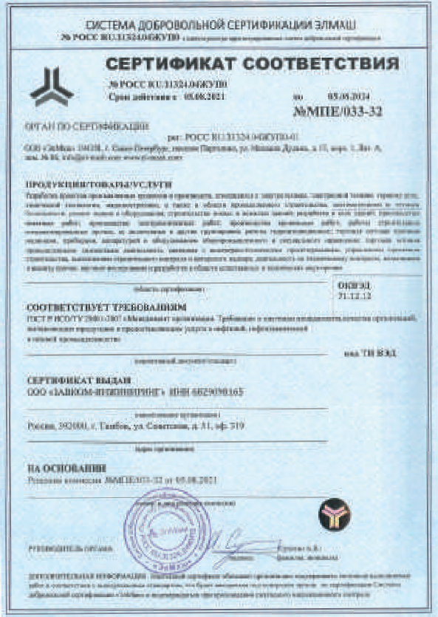
Documents and licences

Slide 28
www.zavkomgroup.com
Head Oﬃce
Address: oﬀ 319, 51 Sovetskaya Street, Tambov, 392000 Russian Federation.
Tel: +74752793722
E-mail: oﬃce@zavkomepc.com
Representative Oﬃce in PR China
COFCOET-ZAVKOM (Wuxi) International Biochemical Technology Co., Ltd. Address: 2nd Floor, 186 Huihe Road, Binhu District, Wuxi, Jiangsu, 214035, PR China.
Permanent Representative to PR China
(inquiries in Russian, Chinese and English)
Tel: +8613810181318
Mob: +8613301631318
Email: matveev@zavkomepc.com

